Slide 1
Introduction to the NIS: Initiatives and Progress of Implementation
Md. Abul Kalam Azad
Principle Secretary to the Prime Minister

Slide 2
What is NIS?
A national strategy document for promoting good governance through promotion of integrity and prevention of corruption

Slide 3
Vision, Mission of the NIS
Vision:
A happy and prosperous Golden Bengal
Mission:
Establishment of good governance in state and society

Slide 4
Goal:
Establishment of a transparent executive organ of the State, which is responsive to the demands and needs of people.

Slide 5
Concept of Integrity
Synonyms of integrity:
honesty, probity, rectitude, ethics, morals, righteousness, morality, honor, good character, principles, virtue, decency, fairness, scrupulousness, sincerity, truthfulness, trustworthiness
Integrity in this document means:
behavioural excellence influenced by morality and honesty;
and
adherence to time-tested norms, values, customs and principles of a society;

Slide 6
Previous Measures towards Integrity
Spirit of the Constitution: A just and righteous society;
Combating corruption has been a continuous effort. For example:
Penal Code, 1860;
Prevention of Corruption Act, 1947;
Government Servant (Conduct) Rules, 1979;
Government Servant (Discipline & Appeal) Rules, 1985;
Reorganization of the ACC, 2004;
Public Procurement Act/ Rules, 2006/2008;
Right to Information Act, 2009;
Whistle-blowers’ Protection Act, 2011;
Prevention of Money Laundering Act, 2012.

Slide 7
Rationale for Adopting NIS
Need for coordination among different regulatory measures and interventions;
Development interventions of Government and NGOs have grown extensively;
Corruption identified as a major concern in Government Policy documents:
Sixth Five Year Plan 2011-15
Perspective Plan of Bangladesh 2010-21
United Nations Convention Against Corruption (UNCAC) requires formulation of a Strategy to fight corruption.

Slide 8
Article 5. Preventive anti-corruption policies and practices
Each State Party shall, in accordance with the fundamental principles of its legal system, develop and implement or maintain effective, coordinated anti-corruption policies that promote the participation of society and reflect the principles of the rule of law, proper management of public affairs and public property, integrity, transparency and accountability.
2. Each State Party shall endeavor to establish and promote effective practices aimed at the prevention of corruption.

Slide 9
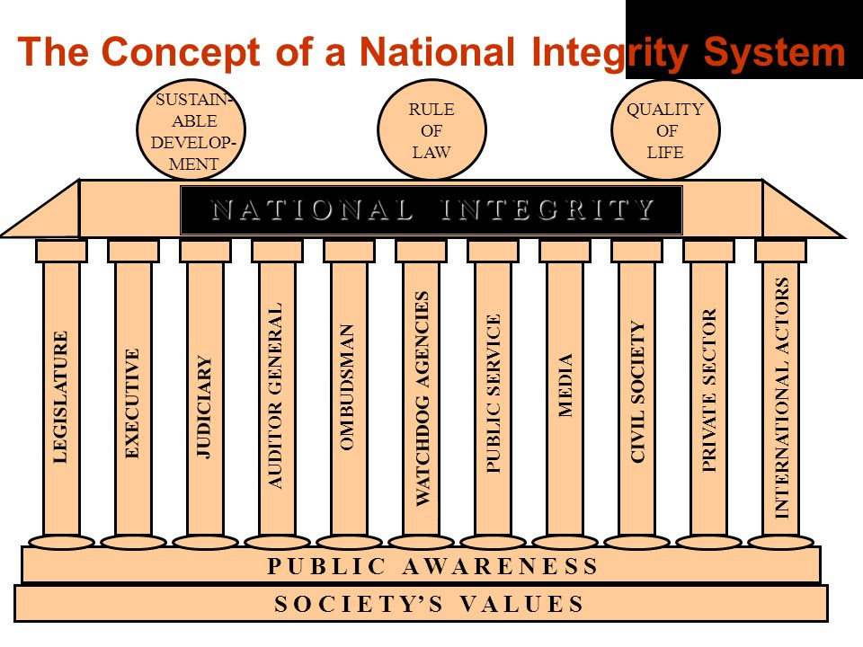
NIS Framework

Slide 10
Institutions of NIS
State Institutions
Executives and Public Administration
Parliament
Judiciary
Election Commission
Office of Attorney General
Public Service Commission
Office of Comptroller and Auditor General
Ombudsman
Anti-Corruption Commission
Local Government

Slide 11
Institutions of NIS(cont.)
Non-State Institutions
Political parties
Private sector
NGO / Civil Society
Educational Institutions
Media
Family

Slide 12
Strategy for Attaining Integrity
Identification the contexts and challenges faced by different state and non-state institutions;
Sets goals of the institutions to ensure integrity;
Makes short, medium & log-term recommendations for achieving the goals;
Suggests time-bound action plan for implementation of these recommendations
Short term - 1 year, medium term - 3 years, long term - 5 years.

Slide 13
Executive Organ and Public Administration
Challenges:
Promulgation of a Civil Service Act;
Increasing functional freedom of public services with accountability;
Enhancing efficiency and effectiveness;
Establishing links between promotion, transfer, pay and emoluments with appraised performance;
Introduction of a competitive pay and incentive structure;
Overall reform by ensuring equitable opportunities for different cadre services;
Building citizen-friendly enforcement agencies;
Fair, neutral and visible decision-making.

Slide 14
Executive Organ and Public Administration (Cont.)
Short-term Recommendations
Making systemic arrangements for submission of asset statements;
Proper enforcement of ‘Whistle Blowers’ Protection Act;
Dealing with grievances by operationalising the ‘Grievance Redress System’;
Introduction of modern performance appraisal, incentive and emolument systems;
Ensuring appointment of government officers and employees on a regular basis.

Slide 15
Executive Organ and Public Administration
Medium and Long term Recommendations (Cont.)
Enactment of Civil Service Act;
Establishment of an efficient, accountable, qualified and responsive executive organ by ensuring ‘career development’;
Providing in-service training for developing capacity;
Introduction of a competitive promotion system based on a combination of seniority, merit, efficiency and performance;
Expansion of e-governance system;
Framing a just pay-structure for the public servants with provisions for adjustments with cost of living.

Slide 16
Major Recommendations of the NIS (Cont.)
Enactment of Civil Service Act;
Making systemic arrangements for submission of asset statements;
Operationalising the ‘Grievance Redress System’;
Introduction of modern performance appraisal, incentive and emolument systems;
Providing in-service training for developing capacity;
Expansion of e-governance system;
Framing a just pay-structure for the public servants with provisions for adjustments with cost of living.

Slide 17
Executive Organ and Public Administration Action Plan
Sl. | Interventions | Performance Indicator | Time-frame | Responsibility | Supported by
1. | Enactment of Civil Service Act | Civil Service law enacted | Medium term | Ministry of Public Administration | Legislative and Parliamentary Affairs Division
2 | Formulation of Career Plan | Career Plan formulated; transparency established and fairness ensured in promotion | Medium term | Ministry of Public Administration | Cabinet Division
3. | Introduction of participatory appraisal system | Newly formulated system followed | Short term | Ministry of Public Administration | All other Ministries/ Divisions
4. | Regular submission of income and asset statements to specified authorities | Statements submitted on a regular basis | Short term | Ministry of Public Administration | All other Ministries/ Divisions
5. | Better pay and facilities for officers and employees | Establishment of permanent Pay and Service Commission | Long term | Finance Division | Cabinet Division

Slide 18
Executive Organ and Public Administration Action Plan
Sl. | Interventions | Performance Indicator | Time-frame | Responsibility | Supported by
6. | Establishment of ICT for introduction of e-governance | a) ICT introduced and used in all Min/Div; (b) volume and quality of services increased and improved by ICT use | Short term | Ministry of Information and Communication Technology | Cabinet Division
7. | Introduction of Complaint Management | Each public office has a ‘GRS focal point’ and is publicly known | Short term | Cabinet Division | All other Ministries/ Divisions
8. | Clustering of Ministries/ Divisions | Min/Div divided in clusters, gazette notified | Long term | Ministry of Public Administration | Cabinet Div; All Min/Div
9. | Enactment of Whistle Blowers’ (Protection) Act | Whistle Blowers’ (Protection) Act, 2011; enforced | Implemented | Legislative and Parliamentary Affairs Division | Cabinet Division
10. | Establishment of separate agency for investigation | Law published in the official Gazette | Short term | Ministry of Home Affairs | Legislative and Parliamentary Affairs Division
11. | Modernisation of land management and implementation of Land Use Plan | Digitised land management system established | Medium term | Ministry of Land | Ministry of Public Administration
12. | Strict handling of marketing of adulterated food, medicine and goods | Adulteration Act enforced | Short term/ continuously | BSTI, Ministry of Industries | Ministry of Home Affairs

Slide 19
Major Recommendations of the NIS
Capacity development of the ACC and ensuring independence of ACC;
Ensuring neutrality and enhancing accountability of the Commission
Raising awareness among government organisations, businesses, civil society and media on corruption
Capacity Development of the elected representatives, officers and employees of LGs
Introduction of ‘Local Government Service’
Protecting consumers’ rights;

Slide 20
Major Recommendations of the NIS
Promotion of enhanced transparency in NGO functioning
Avoidance of duplication and overlap in the interventions of the Government and NGOs
Encouraging and supporting the children and youths participating in voluntary, patriotic and welfare activities
Promotion of Ethics in academic education;
Strengthening Press Council;
Promotion of integrity in the media;
Proper implementation of the Right to Information Act;

Slide 21
Implementation Arrangement
Arrangement in Section Four:
Brief and flexible arrangement
Self initiative considering high importance of integrity
Coordinated by the executive
Approach:
Development of administrative system and process
Development skills of officials
Regulatory and administrative reforms
Monitoring and evaluation
Award for the best practitioners

Slide 22
Implementation Arrangement
Institutional Arrangements
1. Central Level:
National Integrity Advisory Council;
Executive Committee of the Council;
National Integrity Implementation Unit (NIIU – Cabinet Division);
2. Ministry Level:
Ethics Committee at every Ministry/Division and Institutions;
Focal Point for every Ethics Committee;
3. NGO and Private Sector: NOGAB and M/O Commerce (Preparation of Guideline)

Slide 23
Ethics Committee
Headed by the Secretary in Ministry/Division
Head / 2nd man in NIS Institutions;
Heads of extension departments members;
Member Secretary is the ‘focal point’;
ToR for Ethics Committee:
Identification of challenges of promotion of integrity and good governance;
Prepare time-bound work-plan to overcome challenges;
Fixing responsibilities for implementation of the work-plan;
Monitoring implementation of work-plan;
Reporting to the NIIU on progress

Slide 24
Ethics Committee (work plan)
Action
Revise work-plan
Plan
Stakeholders’ meeting
DO
Distribute responsibilities
Check
Conduct regular Ethics Committee meeting
Identify governance challenges
Prepare individual work-plan
Provide necessary budget
Monitor and evaluate implementation
Implement plan/activities
Include new activities
RTI>GRS>E- governance>skills
Share experiences

Slide 25
Progress of NIS Implementation
Dissemination of the NIS
Ethics Committees are functioning
Ministries/Divisions prepared work-plans
Focus on RTI, E-governance, GRS increased
Training and capacity development initiatives increased
Annual Performance Management System introduced
Sub-committee formed in priority areas
NIS Support Project started with technical assistance from JICA

Slide 26
Potentials of the NIS
Constitutional responsibility of the state to promote good governance
Most of the contemporary issues that affect governance are included
Reformative, not revolutionary
Reflection of a positive intention of the Government
Bringing the good governance agenda in the front
Increasing demand for good governance

Slide 27
Possible initiatives of the Ministries
Integrity as a thought-provoking and critical issue of governance among officials
Involve officials in creative activities on integrity and governance (exercise, souvenir, cultural and literary activities etc.)
Introduce successful initiatives and legendary personalities on integrity and honesty
Encourage leadership development, self-initiatives and innovation for good governance
Feedback and recommendations to NIIU

Slide 28
_{Way Forward}
Involving citizens and stakeholders
Effective coordination among institutions for synergy
Focused activities within the watch-dog institutions
Promoting good practices
Prioritizing service delivery

Slide 29
Thank You

